Slide 1
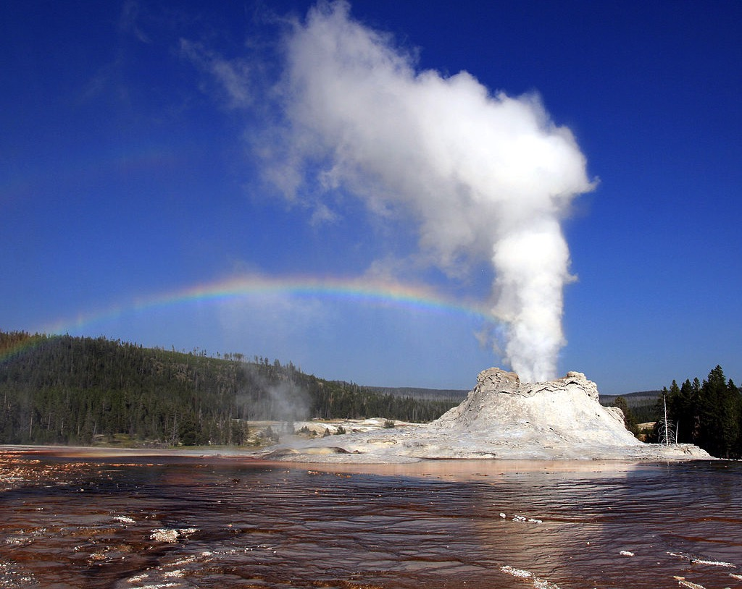
Sustainable source of energy – Geothermal energy
Renewable source of energy: Geothermal

Slide 2
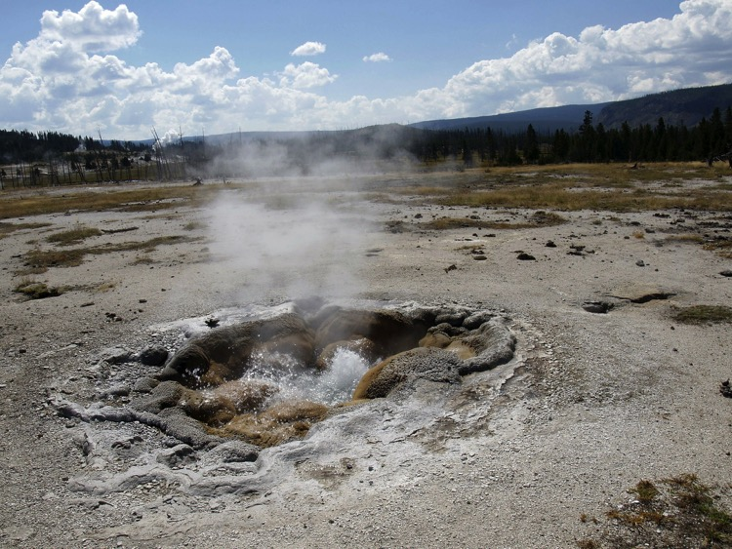
What is a geothermal energy source?
A geothermal energy source uses heat from below Earth’s surface for heating and generating electricity.

Slide 3
Geothermal energy
‘Geo’ is the Greek word for ‘the earth’ and ‘thermal’ is the Greek word for ‘heat’ — so geothermal means ‘heat from the earth’.
The temperature at the centre of Earth is over 5000 ˚C and 200–400 ˚C in parts of Earth’s crust.
It is a renewable energy source.
It is a sustainable resource.
Is used all around the world for heating and generating electricity.
It has been used for thousands of years. It was used by the ancient Romans for heating buildings and water for bathing.

Slide 4
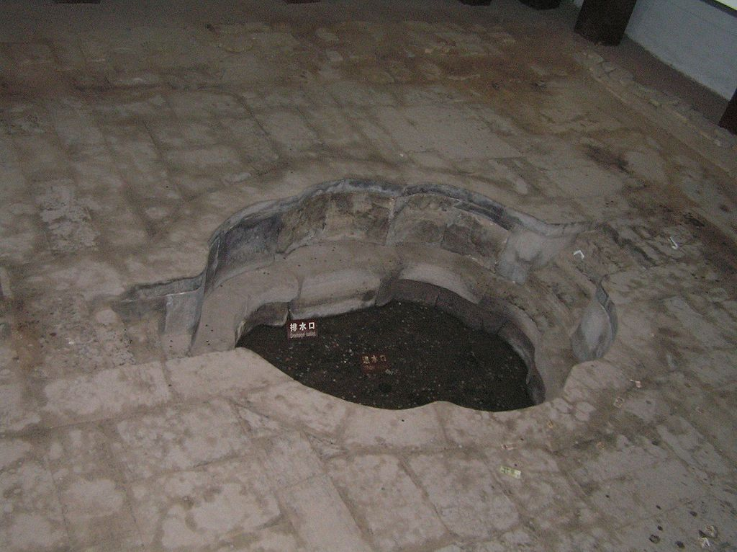
This is the oldest known hot-spring bath built in the third century BCE in China.

Slide 5
How does it work?
In general, geothermal power stations use heat from the earth to produce steam.
Holes are drilled down (about 2 km) to access underground geothermal reservoirs.
The hot water and steam are piped up to the power plant to spin the turbines and generate electricity.
In 2015, 24 countries had geothermal power stations to generate electricity.

Slide 6
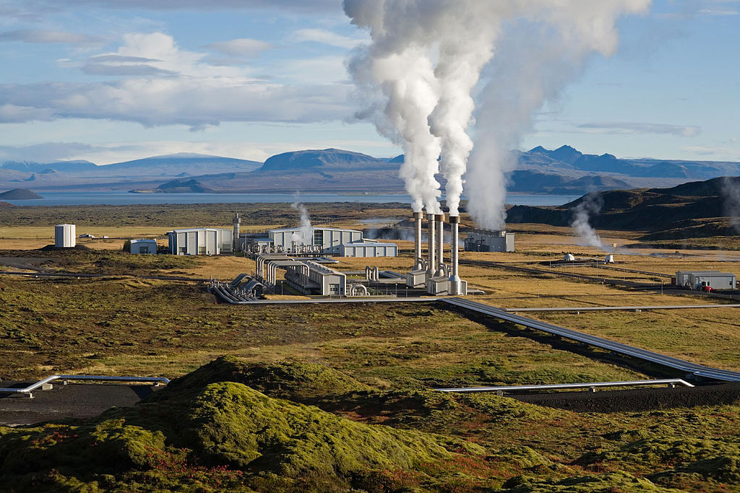
This power plant is the Nesjavellir Geothermal power station in Iceland. Iceland generates 100 per cent of its electricity from renewable energy sources. Geothermal energy produces 25 per cent and hydroelectric power produces 75 per cent.

Slide 7
Attributions
Slide 1: Brocken Inaglory, Steam phase eruption of Castle Geyser with double rainbow, http://commons.wikimedia.org/wiki/File:Steam_Phase_eruption_of_Castle_geyser_with_double_rainbow.jpg CC BY-SA 3.0 creativecommons.org/licenses/by-sa/3.0/deed.en
Slide 2: http://pixabay.com/en/yellowstone-national-park-wyoming-215196/
Slide 4: Ytrottier, Oldest geothermal, http://commons.wikimedia.org/wiki/File:Oldest_geothermal.jpg CC BY-SA 3.0 creativecommons.org/licenses/by-sa/3.0/deed.en
Slide 6: http://commons.wikimedia.org/wiki/File:NesjavellirPowerPlant_edit2.jpg

